Slide 1
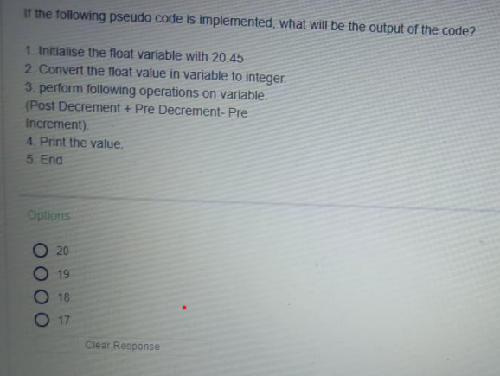
Ans : 19
Step-by-step explanation:
The float variable is initialized with 20.45.
The float value is converted to integer. The integer value is 20.
The following operations are performed on the variable:
Post decrement: The value of the variable is decremented by 1. The value becomes 19.
Pre decrement: The value of the variable is decremented by 1 before any other operations are performed. The value becomes 18.
Pre increment: The value of the variable is incremented by 1. The value becomes 19.
The value of the variable is printed. The value is 19.

Slide 2
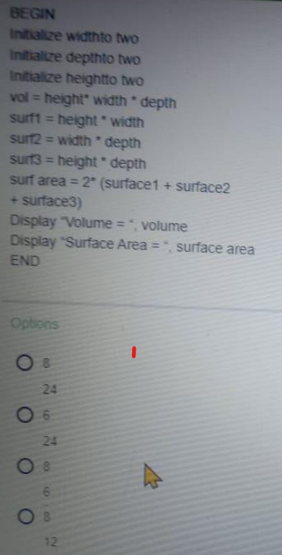
The correct output is 8 , 24.
Here is the step-by-step explanation:
The width, depth, and height are initialized to 2.
The volume is calculated as height * width * depth = 2 * 2 * 2 = 8.
The surface area is calculated as 2 * (surf1 + surf2 + surf3)
surf1 = height * width = 2 * 2 = 4
surf2 = width * depth = 2 * 2 = 4
surf3 = height * depth = 2 * 2 = 4 Therefore, surface area = 2 * (4 + 4 + 4) = 24
The volume = 8 and surface area = 24 are displayed.

Slide 3
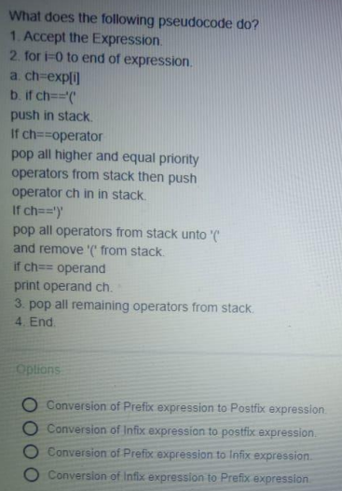
Ans : conversion of an infix expression to a postfix expression.

Slide 4
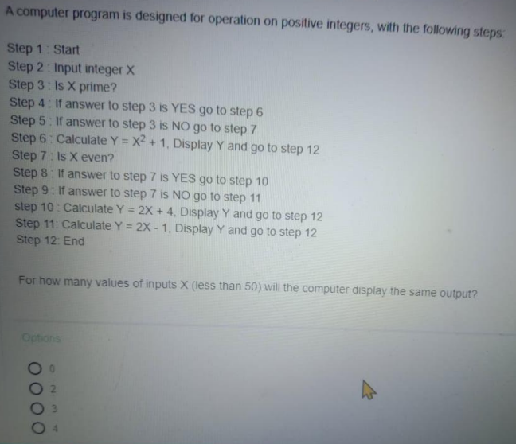
Ans : The computer will display the same output for 0 values of inputs X (less than 50).

Slide 5
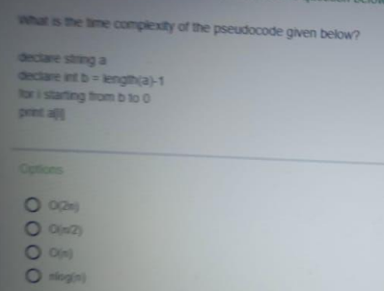
Ans : O(N)

Slide 6
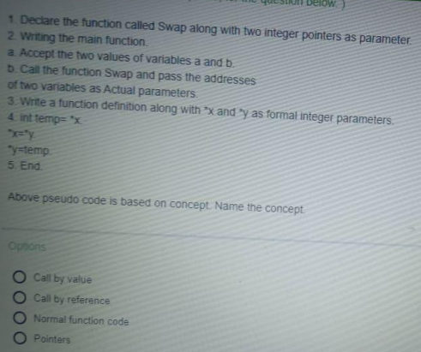
Ans : call by reference

Slide 7
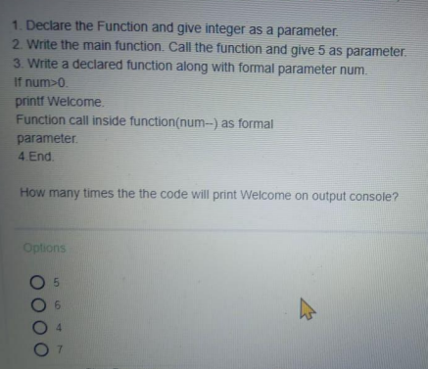
Ans : 5

Slide 8
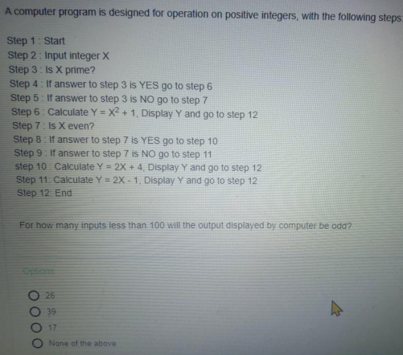
Ans: None of the above
The number of inputs less than 100 that will produce an odd output is 51

Slide 9
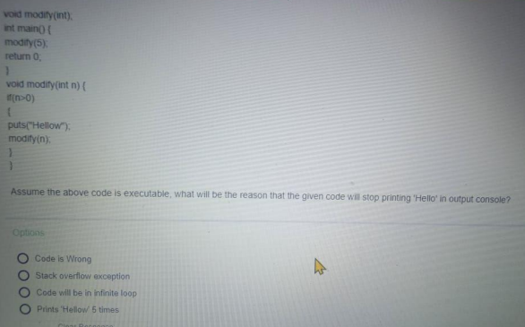
Ans: Code will be in an infinite loop

Slide 10
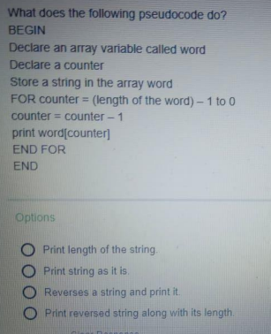
Ans: Reverses a string and print it

Slide 11
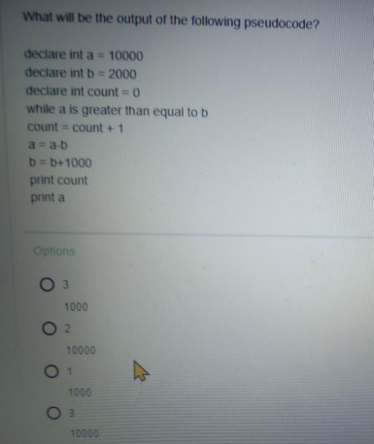
Ans :
3
1000

